Slide 1


Big Data Seminar – BIA 678
Data Stream Analytics - Introduction
David Belanger PhD
Senior Research Fellow – Stevens Institute of Technology
dbelange@stevens.edu
“More data beats clever algorithms, but better data beats more data” : Peter Norvig

Slide 2
Class 8 Outline
Administrative Stuff:
Think about team projects – abstract 04/02/2019.
Next couple of weeks: Starting Recomender Systems and Ensembles
Activity #1 –Week’s Readings
Data Stream Mining, A Survey Gupta, Rajput, http:citeseerx.ist.psu.edu/viewdoc/download?doi=10.1.1.415.1674&rep=rep1&type=pdf
Team Projects, Homework, etc.
Assignment #1 – Next Week’s Readings
A Survey of Collaborative Filtering Techniques : Su & Khoshgoftaar: on canvas
Class 8 - Spring 2018 Comparison of Collaborative Filtering Algorithms GATECH - Joonseok Lee, Mingxuan Sun, Guy Lebanon
Activity #2 – Data Stream Analysis

Slide 3
Class 8 Outline
Looking Ahead – Readings on Data Analysis :
Next Week Assignment:
Recommender Systems:
A Comparative Study of Collaborative Filtering Algorithms,
Joonseok Lee, Mingxuan Sun, Guy Lebanon
- A Survey of Collaborative Filtering Techniques : Su & Khoshgoftaar: on canvas
04/09/2019 Assignment:
Ensemble Systems:
Tutorial on Boosting, Yoav Freund Rob Schapir, on CANVAS
04/16/2018
XGBoost: A Scalable Tree Boosting System Tianqi Chen and Carlos Guestrin, ACM from Library or CANVAS

Slide 4
Data Stream Analytics A Very Short Introduction (For more: BIA676)

Slide 5
Review DBMS vs. DSMS
Traditional DBMS:
stored sets of relatively static records with no pre-defined notion of time
good for applications that require persistent data storage and complex querying
DSMS:
support on-line analysis of rapidly changing data streams
data stream: real-time, continuous, ordered (implicitly by arrival time or explicitly by timestamp) sequence of items, too large to store entirely, not ending
continuous queries

Slide 6
Review DBMS vs. DSMS
DBMS
Persistent relations (relatively static, stored)
One-time queries
Random access
“Unbounded” disk store
Only current state matters
No real-time services
Relatively low update rate (no longer true)
Data at any granularity
Assume precise data
Access plan determined by query processor, physical DB design
DSMS
Transient streams (on-line analysis)
Continuous queries (CQs)
Sequential access
Bounded main memory
Historical data is important
Real-time requirements
Possibly multi-GB arrival rate
Data at fine granularity
Data stale/imprecise
Unpredictable/variable data arrival and characteristics
Often fed by “collector” systems
Adapted from [Motawani: PODS tutorial]

Slide 7
Data Stream Analytics Volume Reduction
Sampling
Sketching

Slide 8
Data Stream Analytics Data Analysis
Classification
Concept Drift
Regression
Clustering
Frequent Itemset Mining
Anomaly Detection
Distributed Streams

Slide 9
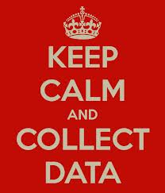
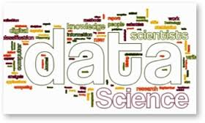
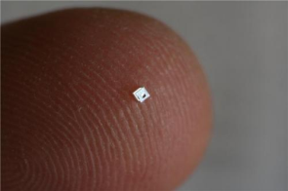
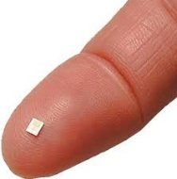
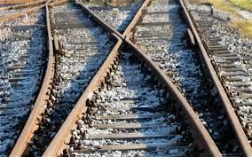



Big Data Lifecycle: For Machines
Analyze
Decide
Control
Monitor
Instrument
Internet of Things
Big Data
Notes:
http://phys.org/news/2014-03-lifesaving-sensor-full-bladders.html
Rasberry Pi
Tee Shirt Label.

Slide 10
Data Stream Analytics
Source: Big Data Stream Mining Tutorial – Bifet et al, IEEE Big Data 2014

Slide 11
Data Stream Analytics Example Sources

Slide 12
Data Stream Analytics Approximation
General Idea: Small error, ε, with high probability 1-δ
Given a true hypothesis H, and a learned hypothesis H^
Pr [ | H – H^ | < ε |H| ] > 1 - δ
1 - δ
ε |H|

Slide 13
Sampling
Use of Samples well known from Statistics Courses.
As always, the key is to obtain a random sample to represent the population.
From that sample, we would like to generate one or more unbiased estimators (e.g. count, mean, sum, variance, …)
In addition we would like to have error bounds (e.g. Hooeffdling (sum, mean), Chernoff (count).

Slide 14
Sampling
Goal: Sample m items uniformly from a stream
Problem: We don’t know how long the stream is, and it could be effectively infinite.
Some approaches:
Reservoir Sampling
Min-Wise Sampling
“Smart” Sampling

Slide 15
Sampling - Reservoir
Sample first m items
Sample item “i” (i > m) with probability m/i
If sampled, randomly replace a previously sampled item.
Result: sample of size m with decreasing likelihood of selection as stream gets longer.
Result: very hard to parallelize

Slide 16
Sampling – Min-wise
For each item, generate a random number uniformly distributed between 0 and 1.
Store “m” items with the lowest (or highest) random values.
Result: Easy to parallelize followed by merge.
Result: If random number generator is good, can work effectively with a long stream.

Slide 17
Sketches
Problem: Suppose we want to count the distinct items in a stream.
In sampling, many/most items aren’t sampled, so we don’t know their value.
Another approach: Sketching
Model the input stream as a vector.
A sketch is the result of multiplying the input stream vector by a matrix (to be defined).

Slide 18
Sketches
Simple Sketch (CM, Cormode, Muthu’04)
Useful for join aggregates, range queries, moments, …
Given an input stream vector V, of length M
Create a summary array, A, of size d x w
Use “d” hash functions to map vector entries into columns (1…w)
Each element of V is mapped (hashed) into one bucket per row in A
Merge sketches by matrix summation
Estimate V(j) = min(k) of {A{k, hash_{k} (j)}

Slide 19
Sketches
Sketches provide approximation error guarantees, and though not general, CM can count distinct values and calculate approximate moments.

Slide 20
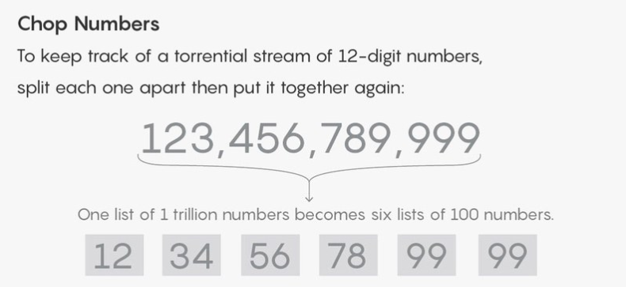

BEST-EVER ALGORITHM FOUND FOR HUGE STREAMS OF DATA – Kevin Hartnett, Science

Slide 21
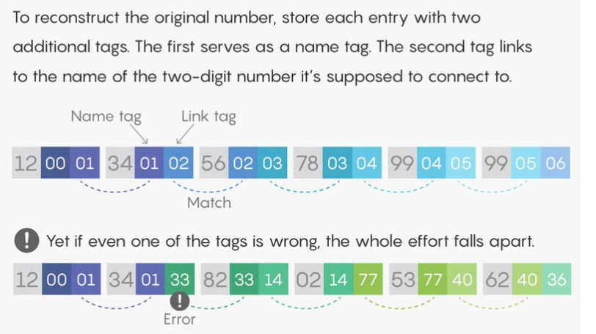
BEST-EVER ALGORITHM FOUND FOR HUGE STREAMS OF DATA – Kevin Hartnett, Science

Slide 22
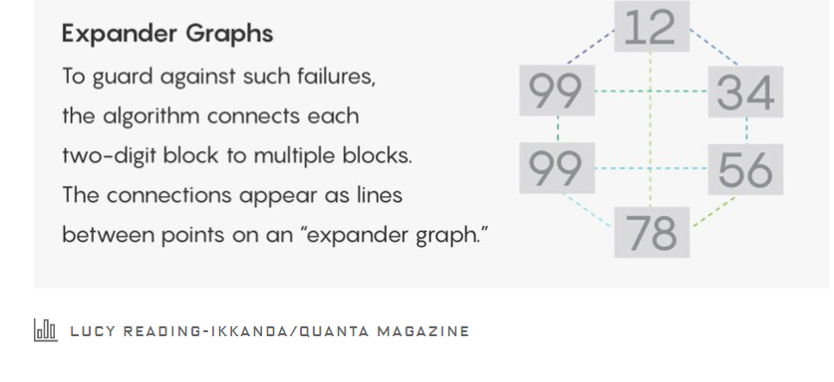
BEST-EVER ALGORITHM FOUND FOR HUGE STREAMS OF DATA – Kevin Hartnett, Science

Slide 23
Issues in Data Stream Analysis
Descriptive Statistics
Sampling
Sketches
Classification and Regression
Content Drift

Slide 24
Traditional vs Stream Analytics
Traditional Processing | Stream Processing
Off-line Processing | Real-time Processing
Normal or slow data generation relative to available computational resources | Rapid data generation relative to available computational resources
Storage of data is feasible | Storage of data is not feasible (one Pass)
Accurate results are required (usually) | Approximate results are often acceptable (i.e best that can be done).
Storage of raw data is often possible | Storage of aggregated and summarized data only, except for anomaly detection.
Spatial and temporal contexts are often considered for classes of applications | Spatial and temporal contexts are particularly important
Algorithms with high space and time complexity are used if required. | Linear and sublinear algorithms are often used, for both space and time.

Slide 25
Big Data Stream Analytics
Classification
Regression
Clustering
Other topics
Drift – Stability
Frequent or Rare Items

Slide 26
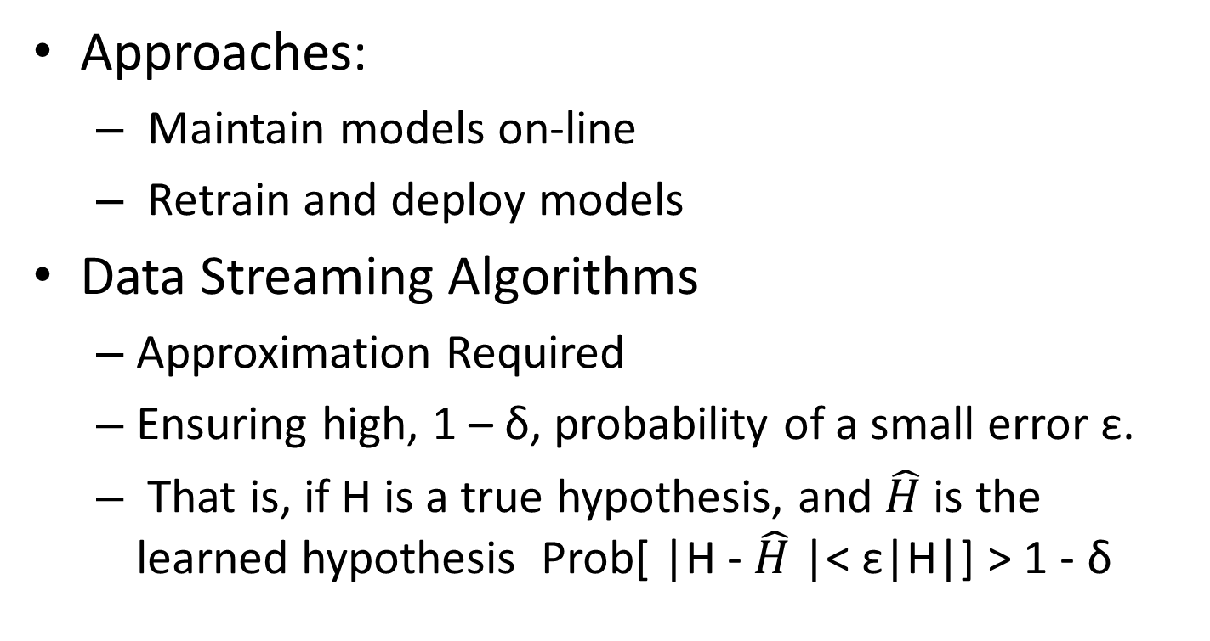
Big Data Stream Analytics
Approaches:
Maintain models on-line
Retrain and deploy models
Data Streaming Algorithms
Approximation Required
Ensuring high, 1 – δ, probability of a small error ε.
That is, if H is a true hypothesis, and $\hat{H}$ is the learned hypothesis Prob[ |H - $\hat{H}$ |< ε|H|] > 1 - δ

Slide 27

EcoSystem Member Systems:
Billing
Inventory
Insurance
…
Cloud:
Fog:
Streaming Architecture:
Upstream Systems
1) Streaming Engine
Data Warehouse
Stream Split and Redirection- Parallel OUtput
Fast Load to Data Warehouse or Stream Data Warehouse
Decision Model Processor
Logs, Aggregations, …
Supporting DBs
Dosage Decisions -
Control
Medical Monitors Data Streams
Memory
Automated Patient Treatment
Data Integration, Query Processing
*
*
2) IQA* Engine
*
Perhaps Hundreds in Parallel
*
*
Deep Analytical Processes
User Reports,
Data Marts,
Data Cubes, Pivot Tables,
Dashboards, …
Decision Model Processor
Fast, In Memory, Classification Data, Models
Memory
* Data Integration, Query
Processing, and Deep Analytics

Slide 28
Data Stream Analytics Classification
Examples:
Email spam
Twitter Sentiment Analyzer
Credit Card Fraud
Health Problem Detection
Process:
One event at a time
Used at most once
Continuous Monitoring
Limited Memory, Time, Complexity, …

Slide 29
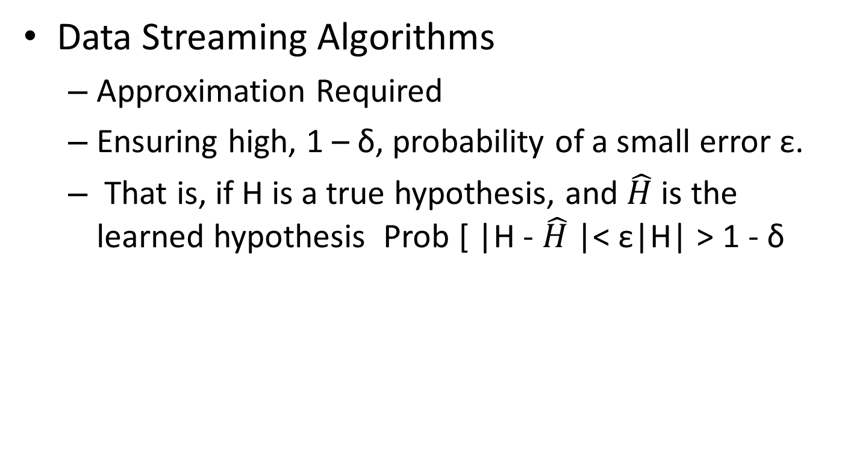
Big Data Stream Analytics Approximation Reminder
Data Streaming Algorithms
Approximation Required
Ensuring high, 1 – δ, probability of a small error ε.
That is, if H is a true hypothesis, and $\hat{H}$ is the learned hypothesis Prob [ |H - $\hat{H}$ |< ε|H| > 1 - δ

Slide 30
Classification - Data Stream Analysis
Assumptions:
Fixed number of independent variables
Ability to process possibly infinite number of events
Limited number of class labels (event types)
Either strict bound on training time, or off-line training
Stationary or evolving Concept Drift
Data exceeds amount of memory available
Source: Fundamentals of Analyzing and Mining Data Streams – Graham Cormode

Slide 31
Classification - Data Stream Analysis
Requirements:
At most single pass. Classify or discard each item only once.
Use as little memory and time as possible
Be ready to predict each input

Slide 32
Classification - Data Stream Analysis
Examples (Most are familiar):
Decision Trees (e.g. C4.5, CART, many more)
Rules
Nearest Neighbor
Support Vector Machines/Neural Networks
Bayesian
Ensemble
Off-line Model Creation

Slide 33
Big Data Stream Analytics Classification
Some Analytic Approaches:
Naïve Bayes Classifier – P ( Y| x)
Neural Nets – e.g. Perceptron
Tree Classifier – Need fast Tree Induction Algorithm.
Data Streaming Algorithms
Tree Classifier
Fast recursive induction
Pre Processing Pruning (stopping) – Stop if no error or threshold probability of error
Example: Hoeffding Tree

Slide 34
Data Stream Analytics Classification – Naïve Bayes
Source: Big Data Stream Mining Tutorial – Bifet et al, IEEE Big Data 2014

Slide 35
Data Stream Analytics Classification – Decision Tree
Source: Big Data Stream Mining Tutorial – Bifet et al, IEEE Big Data 2014

Slide 36
Big Data Stream Analytics
Some Analytic Approaches – Hoeffding Trees:
Small sample may be quite accurate. That is it may be sufficient to consider only a small number of training events that pass through a node to find the best split.
For example, only a few events might be sufficient to find a split for the root.
But: How many events are sufficient?
Hoeffding Bound!

Slide 37
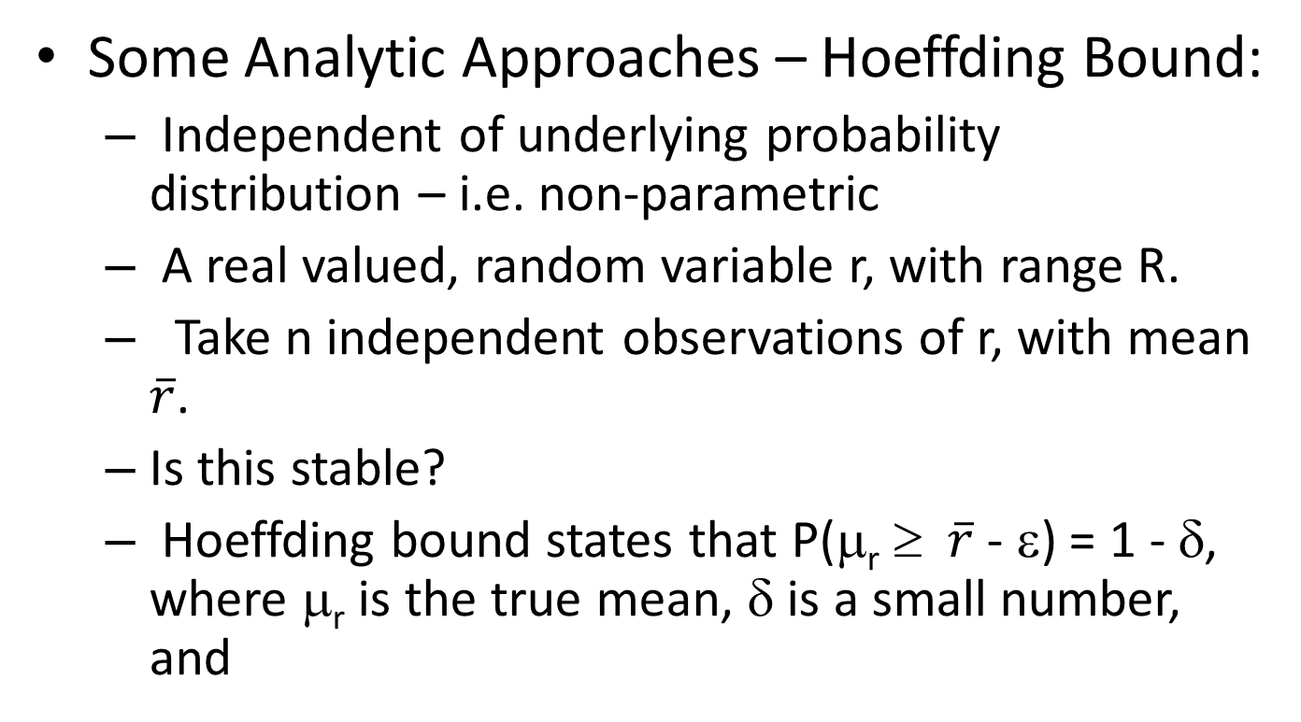
Big Data Stream Analytics (Decision Tree Classification, Tomi Yiu, )
Some Analytic Approaches – Hoeffding Bound:
Independent of underlying probability distribution – i.e. non-parametric
A real valued, random variable r, with range R.
Take n independent observations of r, with mean $\overline{r}$.
Is this stable?
Hoeffding bound states that P(μ_{r} ≥ $\overline{r}$ - ε) = 1 - δ, where μ_{r} is the true mean, δ is a small number, and

Slide 38
Big Data Stream Analytics (Decision Tree Classification, Tomi Yiu, )
Some Analytic Approaches – Hoeffding Bound:
Let G(X_{i}) be the heuristic measure used to choose the split, where X_{i} is a discrete attribute
Let X_{a}, X_{b} be the attribute with the highest and second-highest observed G() after seeing n examples respectively
Let ΔG = G(X_{a}) – G(X_{b}) ≥ 0

Slide 39
Big Data Stream Analytics (Decision Tree Classification, Tomi Yiu, )
Some Analytic Approaches – Hoeffding Bound:
Given a desired δ, if ΔG > ε, the Hoeffding bound states that P(μ_{ΔG} ≥ ΔG - ε > 0) = 1 - δ
μ_{ΔG} > 0 ⇒ μ_{G(Xa)} - μ_{G(Xb)} > 0 ⇒ μ_{G(Xa)} > μ_{G(Xb)}
X_{a} is the best attribute to split with probability 1- δ

Slide 40
Data Stream Analytics Classification – Hoeffding Trees
Source: Big Data Stream Mining Tutorial – Bifet et al, IEEE Big Data 2014

Slide 41
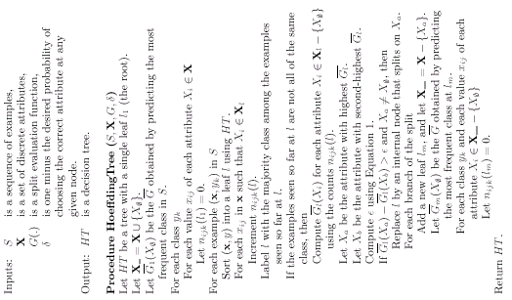
(Decision Tree Classification, Tomi Yiu, )

Slide 42
Big Data Stream Analytics
Some Analytic Approaches – Hoeffding Tree:
Overview:
Number of examples to expand node depends only on Hoeffding Bound
Low variance model – i.e. stable decisions
Low overfitting, No Pruning
Asymptotically close to batch learner
Theoretical guarantees on error rate with high probability
Hoeffding algorithms asymptotically close to batch learner.
Ties: broken when ε small.

Slide 43
Data Stream Analytics Concept Drift
At any event, alarm if there is a distribution change
Source: Big Data Stream Mining Tutorial – Bifet et al, IEEE Big Data 2014

Slide 44
Data Stream Analytics Concept Drift – Cumulative Sum
Source: Big Data Stream Mining Tutorial – Bifet et al, IEEE Big Data 2014

Slide 45
Data Stream Analytics Concept Drift – Cumulative Sum
Source: Big Data Stream Mining Tutorial – Bifet et al, IEEE Big Data 2014

Slide 46
Data Stream Analytics Concept Drift – Statistical Process Control
Source: Big Data Stream Mining Tutorial – Bifet et al, IEEE Big Data 2014

Slide 47
Data Stream Analytics
Source: Big Data Stream Mining Tutorial – Bifet et al, IEEE Big Data 2014

Slide 48
Data Stream Analytics
Source: Big Data Stream Mining Tutorial – Bifet et al, IEEE Big Data 2014

Slide 49
Data Stream Analytics
Source: Big Data Stream Mining Tutorial – Bifet et al, IEEE Big Data 2014

Slide 50
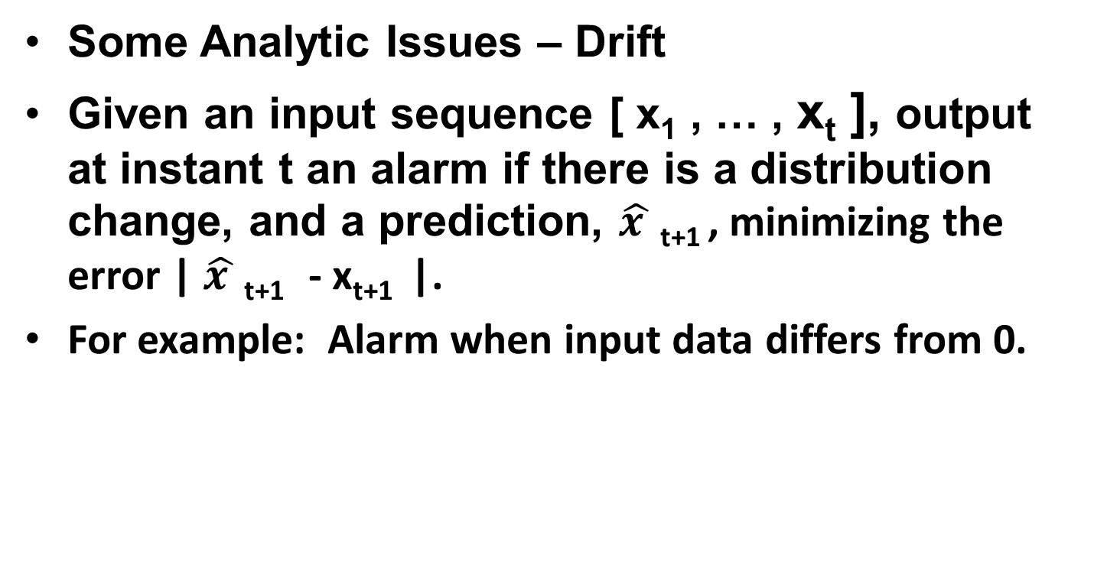
Big Data Stream Analytics (Big Data Stream Tutorial, Morales, et al., IEEE BigData2014 )
Some Analytic Issues – Drift
Given an input sequence [ x₁ , … , x_{t} ], output at instant t an alarm if there is a distribution change, and a prediction, $\hat{x }$ _{t+1} , minimizing the error | $\hat{x }$ _{t+1} - x_{t+1} |.
For example: Alarm when input data differs from 0.

Slide 51
Big Data Stream Analytics
Some Analytic Techniques– Clustering
Goal: Cluster Unsupervised Streams
Common Algorithms include:
Distance Based
Density Based
Many more.

Slide 52
Data Stream Analytics Clustering
Static Examples:
K-Means
DBScan
Many More
Stream Issues:
Clusters May:
Appear
Move
Merge
Points May:
Be Unassigned
Change Clusters

Slide 53
Data Stream Analytics Clustering – Kmeans Based
Source: Big Data Stream Mining Tutorial – Bifet et al, IEEE Big Data 2014

Slide 54
Big Data Stream Analytics
Some Analytic Approaches – Density Based
Algorithm DBSCAN:
Seed algorithm with neighborhood distance - ε
ONLINE Either:
Chain points that are directly reachable from any core point
A Cluster is any set of points that are mutually density connected.

Slide 55
Data Stream Analytics Clusters – Density Based
Source: Big Data Stream Mining Tutorial – Bifet et al, IEEE Big Data 2014

Slide 56
Data Stream Analytics Clusters - DBScan
With DBSCAN, as with K-Means and other clustering techniques, one can seed the stream clustering process with an off-line clustering, and watch for concept drift
This allows one to tune to an appropriate and effective clustering algorithm.

Slide 57
Data Stream Analysis - Clustering
Some Considerations:
For High Dimensional Data (e.g. Similarity of Texts), Complexity can be very high (e.g. O(d²))
Only 1 pass of the data can be used.
Can use Sketches to reduce complexity.
Since one cannot store an entire stream, or even if one could, one can’t see it at any time, we must cluster one (or a set of) events at a time.
We must maintain a summary and update with each new event.
With lower dimensionality, can use something very similar to K-Means.
Source: Fundamentals of Analyzing and Mining Data Streams – Graham Cormode

Slide 58
K-Means Clustering Issue
A Stream:
-5 5 -1 15 25
K-means:
-5 5
Add -1: Means -3 5
Add 15: Means -3 10
Add 25: Means -3 15
(Therefore 5 should move to first cluster, but ….)

Slide 59
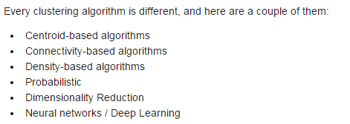
Clustering Techniques (KD Nuggets)

Slide 60
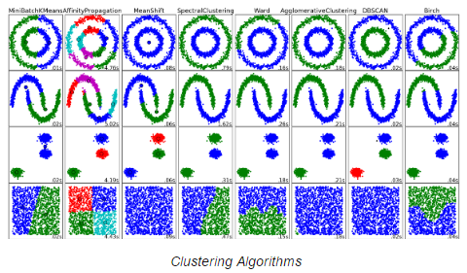
Clustering Techniques (KD Nuggets)

Slide 61
Data Stream Analysis - Clustering
Some Considerations:
There are problems with classification of each event?
There are likely too many events for this to be useful
The clustering, and therefore the cluster any event may be in, can change over time.
The alternative is to output K cluster centers.
Any point can therefore be classified using these centers.
Source: Fundamentals of Analyzing and Mining Data Streams – Graham Cormode

Slide 62
Data Stream Analysis - Clustering
K-means via blocks of streaming data
One of Spark’s Algorithms, basically Lloyd’s Algorithm
Approach:
Divide incoming data into blocks
Often this is done by default for large streams, e.g. by collectors.
Blocks are roughly, but often not exactly, the same size.
Start with a potentially random set of K means
For each new block:
Assign each point to the closest mean, i.e. cluster
Re-compute the cluster means

Slide 63
Data Stream Analysis - Clustering
K-means via blocks of streaming data
Approach:
Divide incoming data into blocks
Often this is done by default for large streams, e.g. by collectors.
Blocks are roughly, but often not exactly, the same size.
Start with a potentially random set of K means
For each new block:
Assign each point to the closest mean, i.e. cluster
Re-compute the cluster means
You may want to reduce the impact of older data
Assign weights to values based on age.
After a time, forget the data (or more likely, let the algorithm forget as part of previous mean).
https://databricks.com/blog/2015/01/28/introducing-streaming-k-means-in-spark-1-2.html

Slide 64
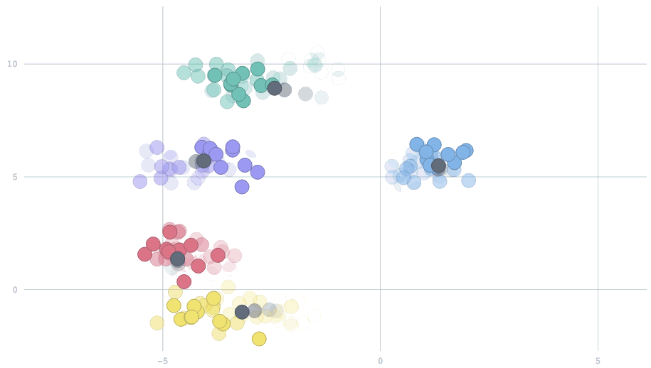

Slide 65
Data Stream Analysis - Clustering
K – Centers (Means):
Goal: Minimize Maximum Diameter (min distance) of each cluster.
Algorithm:
Pick a point for the first center
Repeat:
For each data point, calculate the distance, d_{min} , from the closest center,
Find the data point that maximizes that distance, i.e. d_{min} ,
Add this point to the set of centers.
Until K centers are selected.
If we store the current best center for each point, then each pass requires only O(1) to update new center, else O(K) to update for K centers.
So, time cost is O(KN), with K passes.
Source: Fundamentals of Analyzing and Mining Data Streams – Graham Cormode

Slide 66
Data Stream Analytics Frequent Itemset – an example
Source: Big Data Stream Mining Tutorial – Bifet et al, IEEE Big Data 2014

Slide 67
Data Stream Analytics Frequent Itemsets – example continued
Source: Big Data Stream Mining Tutorial – Bifet et al, IEEE Big Data 2014

Slide 68
Concept Change - Data Stream Analysis
Concept Change
Drift
Shift
Distribution Change
Examples:
CUSUM Test – Alarm when mean of input is significantly different from 0 (standardized).
Similarly Geometric Moving Averages and Weighted Averages.
Hypothesis Tests, e.g. Chi-square difference of means.
Source: Fundamentals of Analyzing and Mining Data Streams – Graham Cormode

Slide 69
Change Detection
Question: How can we monitor a stream of events and detect changes such as:
Change in behavior of some subset of events
Change in patterns or rules detected
Change in underlying distributions, or parameters
Approaches:
Individual items with high frequency change
Use sketches
Fix a distribution and fit parameters
Hypothesis Test
Non Parametric Change Detection
Specify when to call a change significant.
Source: Fundamentals of Analyzing and Mining Data Streams – Graham Cormode

Slide 70
Non Parametric Change Detection Dasu et al, 2006
Measure Change using Kullback-Leibler Divergence (KL)
Generalizes t-test and chi-squared test
KL divergence = D( p||q) = Σ_{x} (p(x) log₂ p(x)/q(x)
For probability distributions p and q
If p, q are distributions over high dimensional spaces, no intersection between samples – need to capture density
Source: Fundamentals of Analyzing and Mining Data Streams – Graham Cormode

Slide 71
Non Parametric Change Detection Space Division Approach
Use a hierarchical space division (kd tree) to define r regions, r_{i} , (approximately equal) weight for the reference data
Compute the discrete probability over the regions
Apply same space division over a window of recent stream events to create q
Compute KL divergence D(p||q)
Source: Fundamentals of Analyzing and Mining Data Streams – Graham Cormode

Slide 72
Non Parametric Change Detection Is KL Divergence Significant?
Use input data to compute a distribution of distances.
Pool reference and first sliding window data, randomly split into two pieces, measure KL difference
Repeat k times, find e.g. .99 quantile of difference.
If KL distance between reference and window > .99 quantile of distances for several steps – CHANGE.
Source: Fundamentals of Analyzing and Mining Data Streams – Graham Cormode

Slide 73
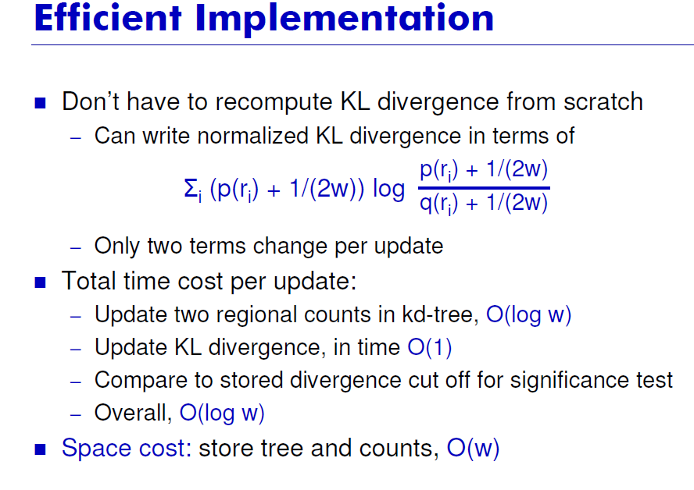
Source: Fundamentals of Analyzing and Mining Data Streams – Graham Cormode

